Slide 1
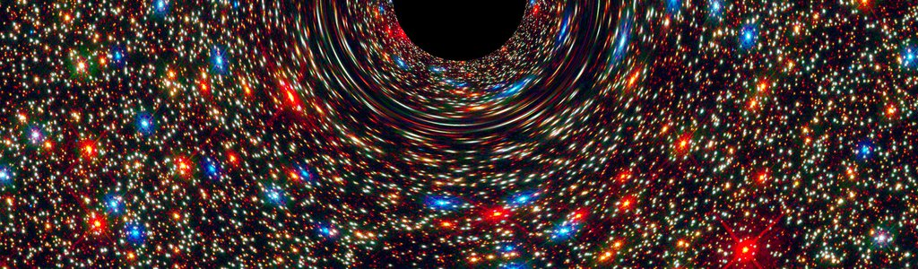
NASA Space Apps Challenge 2020 Challenge: OBSERVE «Hey, what are you looking at?»
Abraham Mateos
Senior member Microsoft Tech Community
Harvard Data Science Professional Certificate
Masters Degree in Big Data ENEB
Estudiando MicroMasters in Statistics and Data Science MIT

Slide 2
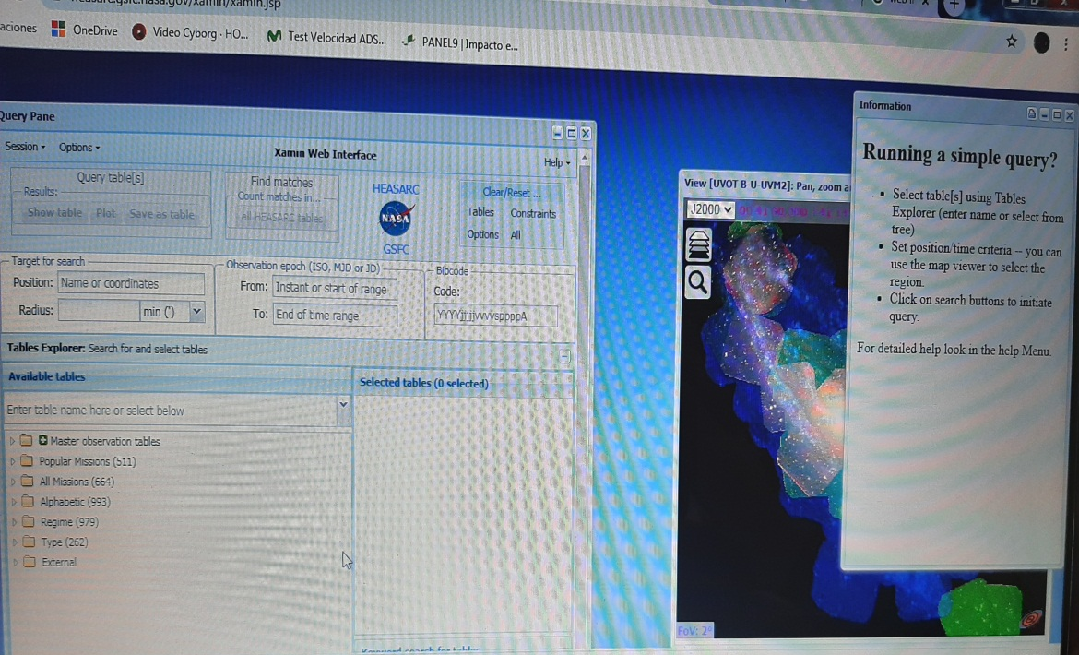
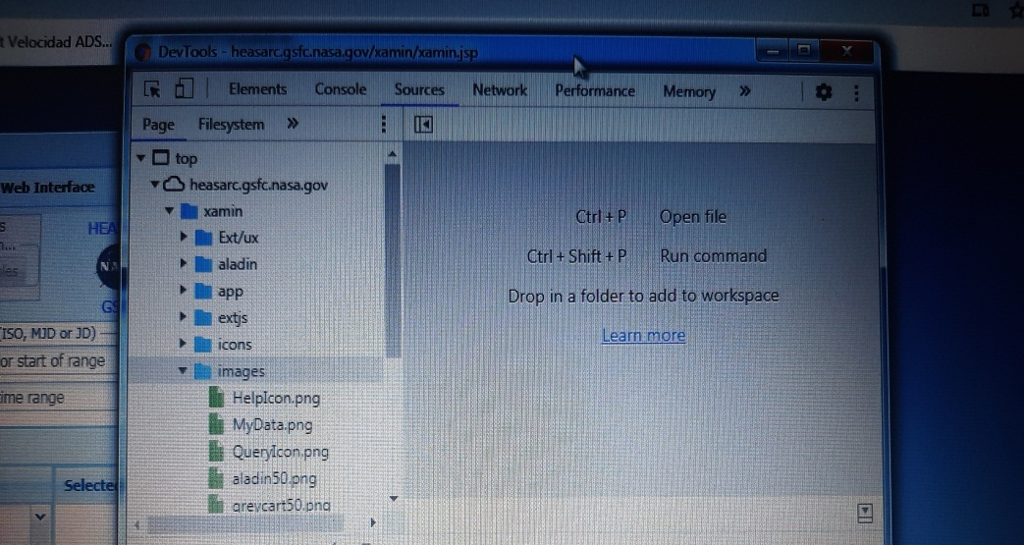
Visualization tool to access photos and content, ¿EASY?
NASA Web Interface
(Xamin Web Interface)
Sources

Slide 3

Energyx.com
Sign in
Account Settings
SECTIONS
Kinds of phenomena
Time range
USER
HEASARC
LAMBDA
XAMIN INTERFACE
Terms and Conditions
Data Privacy Policy
Copyright and Domain

Slide 4

How does Energyx.com work?
Internally, the server is provided with DBs from the HEASARC FTP server, which may be disabled. Thus, we can still access the contents of our ftp area via the http (web) server; on the Web, the top-level of the ftp area is: http://heasarc.gsfc.nasa.gov/FTP/
The heasarc/dbase/dump directory contains dumps of all the browsable catalogs and datasets that the HEASARC has on-line.
DBs from the Center for Astrophysics Supernova Group.
And then…
What is next??
Web algorithm which turns data into images through determined format parameters, proper to pixel designing.

Slide 5
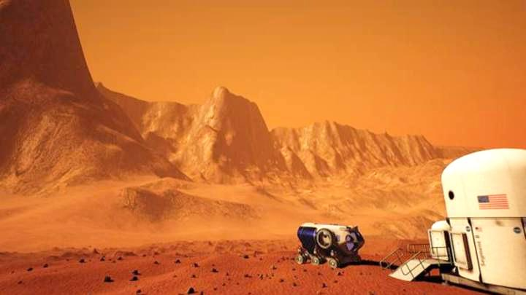
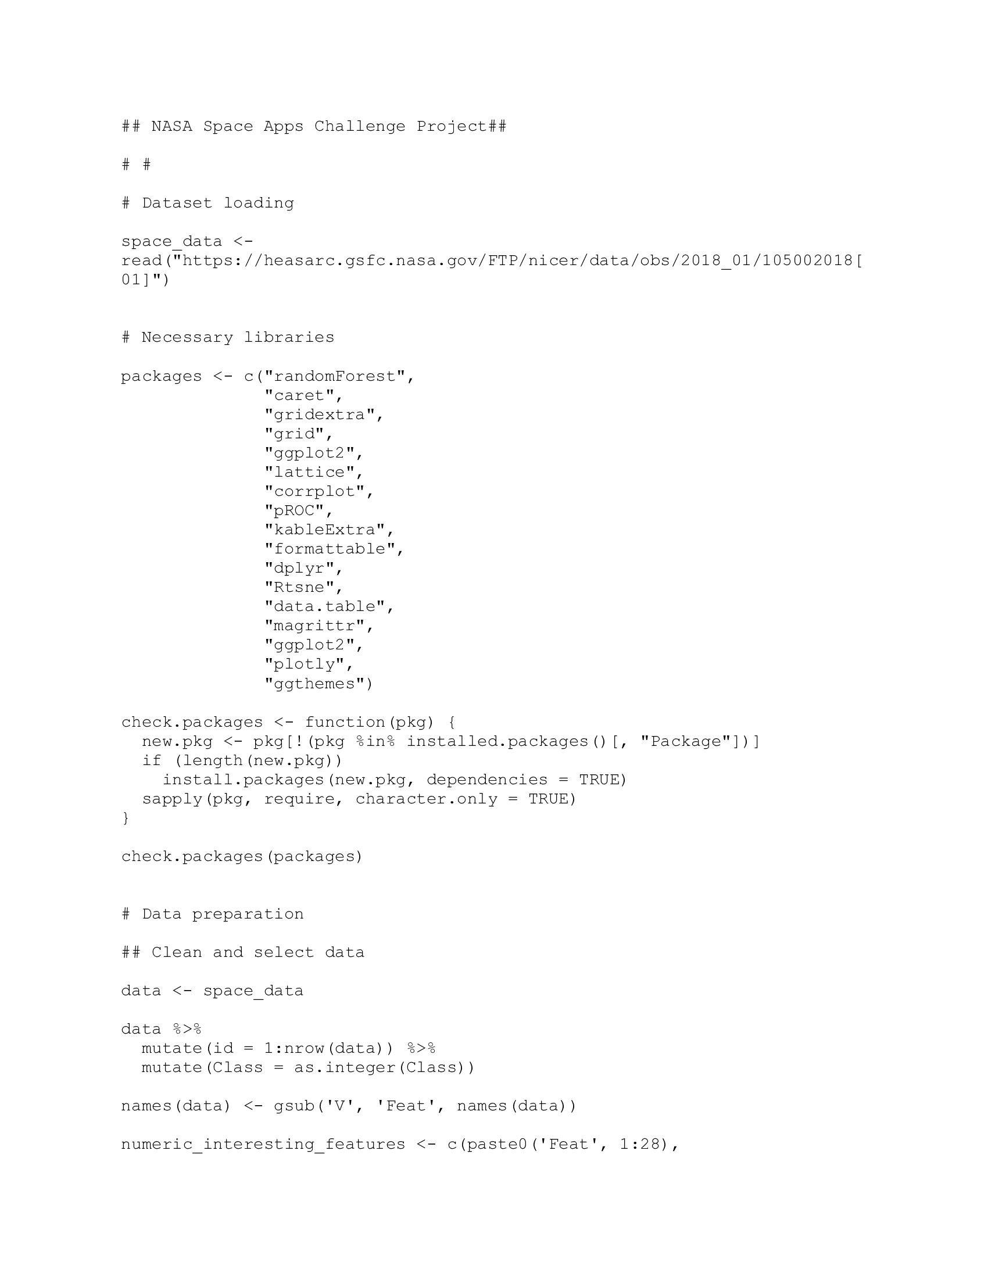
How to improve much more our customers’ experience?
The devised Machine Learning code has been already used with the present and other datasets, and successfully is able to determine predictions about whether our satellite will find out and store images that fit our phenomena search criteria or not, along its long flight outer space…
https://github.com/AMateos91/NASA-Space-Apps-Challenge-2020.git

